Slide 1



Predicting customer churn in SyriaTel
Churn Prediction Modeling:

Slide 2
Introduction
Overview
Developing models to predict customer churn for SyriaTel, a telecommunications company. The goal is to assist the telecom industry in minimizing revenue loss by identifying patterns indicative of customers likely to leave soon.
Business problem
Targeting SyriaTel's business needs, this project aims to optimize customer retention strategies by analyzing predictable patterns, benefiting the company's financial sustainability.

Slide 3
Dataset Overview
The data used in this project is from SyriaTel telecommunications company: https://www.kaggle.com/datasets/becksddf/churn-in-telecoms-dataset.
Variables: some columns in the data are, Customer service calls, total day calls, total eve calls, total intl calls, total night calls, total day minutes etc.
Target variable: churn
We will use this information to predict the future churn and give insights into what can be done to reduce the churn rate by determining what contributes to churn.

Slide 4
Exploratory Data Analysis
Data is clean.
Visualizing Data Distributions to see correlations of various variables.
Identifying Correlations of all variables to churn.
Encoding categorical variables.

Slide 5
Feature Engineering
Created new features Total Call Minutes, Total Call Charges, Average Call Duration, usage patterns, time-of-day patterns, combined features and created binary features.
Significance of Engineered Features: to improve model predictiveness.

Slide 6
Model Selection
Applied the below models:
Baseline Model: Logistic Regression
Complex Model: Random Forest
Hyperparameter Tuning and Optimization

Slide 7
Model Evaluation
Model Performance
Metrics: Accuracy, Precision, Recall, F1 Score, ROC AUC
Baseline Model Metrics: Accuracy: 0.85 Precision: 0.67 Recall: 0.06 F1 Score: 0.11 ROC AUC: 0.53
Complex Model Metrics: Accuracy: 0.97 Precision: 0.97 Recall: 0.83 F1 Score: 0.89 ROC AUC: 0.91
Tuned Model Metrics: Accuracy: 0.97 Precision: 0.97 Recall: 0.83 F1 Score: 0.89 ROC AUC: 0.91
Comparison of Baseline, Complex, and Tuned Models
Baseline model performance is not better than random chance while complex model and tuned model show a strong ability to distinguish variables that affect churn

Slide 8
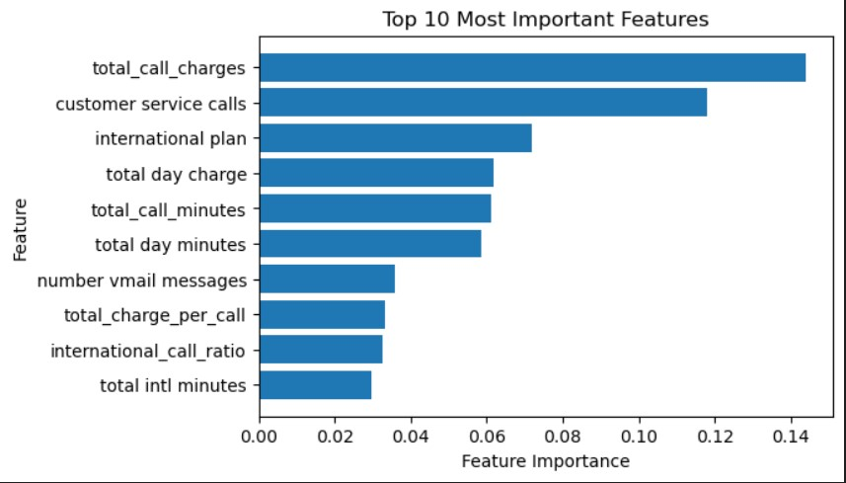
Feature importance
Features most important in predicting churn.

Slide 9
Conclusion
The model was useful in below scenarios:
Customers with high usage patterns give a more accurate prediction for customers who are unlikely to churn.
Customers with shorter contracts are likely to predict churn rate more accurately.
Customers with customer service interactions indicate customer dissatisfaction hence may predict likelihood of churning.
Customer segmentation: factors like age, location influence churn patterns, if specific segments have distinct churn behaviour ,the model can be useful in predicting churn within these segments.

Slide 10
Business recommendations
Focus marketing efforts on customers identified as high risk for churn.
Enhancing customer support to reduce customer service calls.
Product/service enhancements that is the ones that are most popular among long-term customers.
Establish customer feedback channels to understand reasons behind customer churn.

Slide 11
Limitations
Constant change of customer behaviour would not reflect future behaviour clearly.
Unseen patterns not reflected in the data may not present full picture of customer churn reasons.
Incomplete/Limited features or inaccurate data may give wrong or insufficient insights.

Slide 12
THANK YOU!

